Slide 1

Top5
Basketball team MANAGER
https:://github.com/skandermoalla/Top5

Slide 2
Introduction
A team is assigned to the user
The user has his budget
Market
Training
Preparation before the game
One game each week
Save and come back later

Slide 3
ObjectDesign Team
(Structure Team)
3 SubTeams
Game Engine Team
(Algorithm Team)
GUI Team

Slide 4
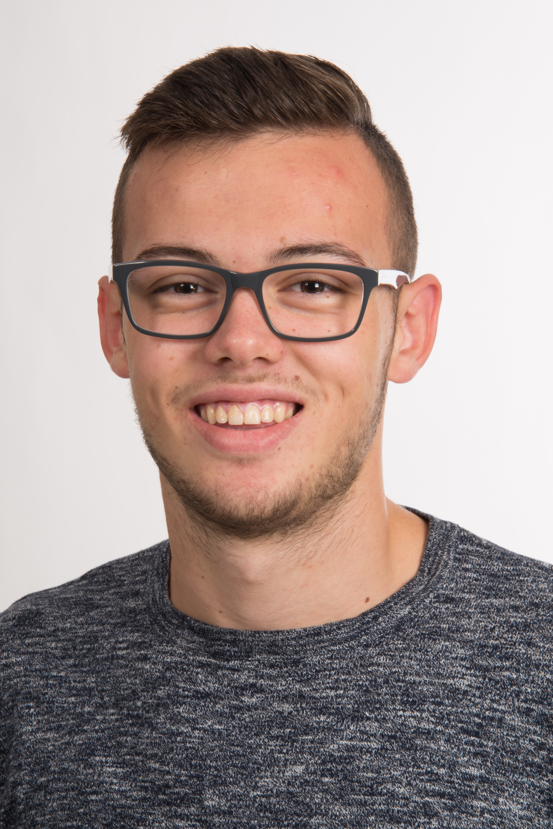



ObjectDesign team
Edison RESHKETA
Assia BENACHIR
Sannya AMOIKON
Mathilde JACQ

Slide 5
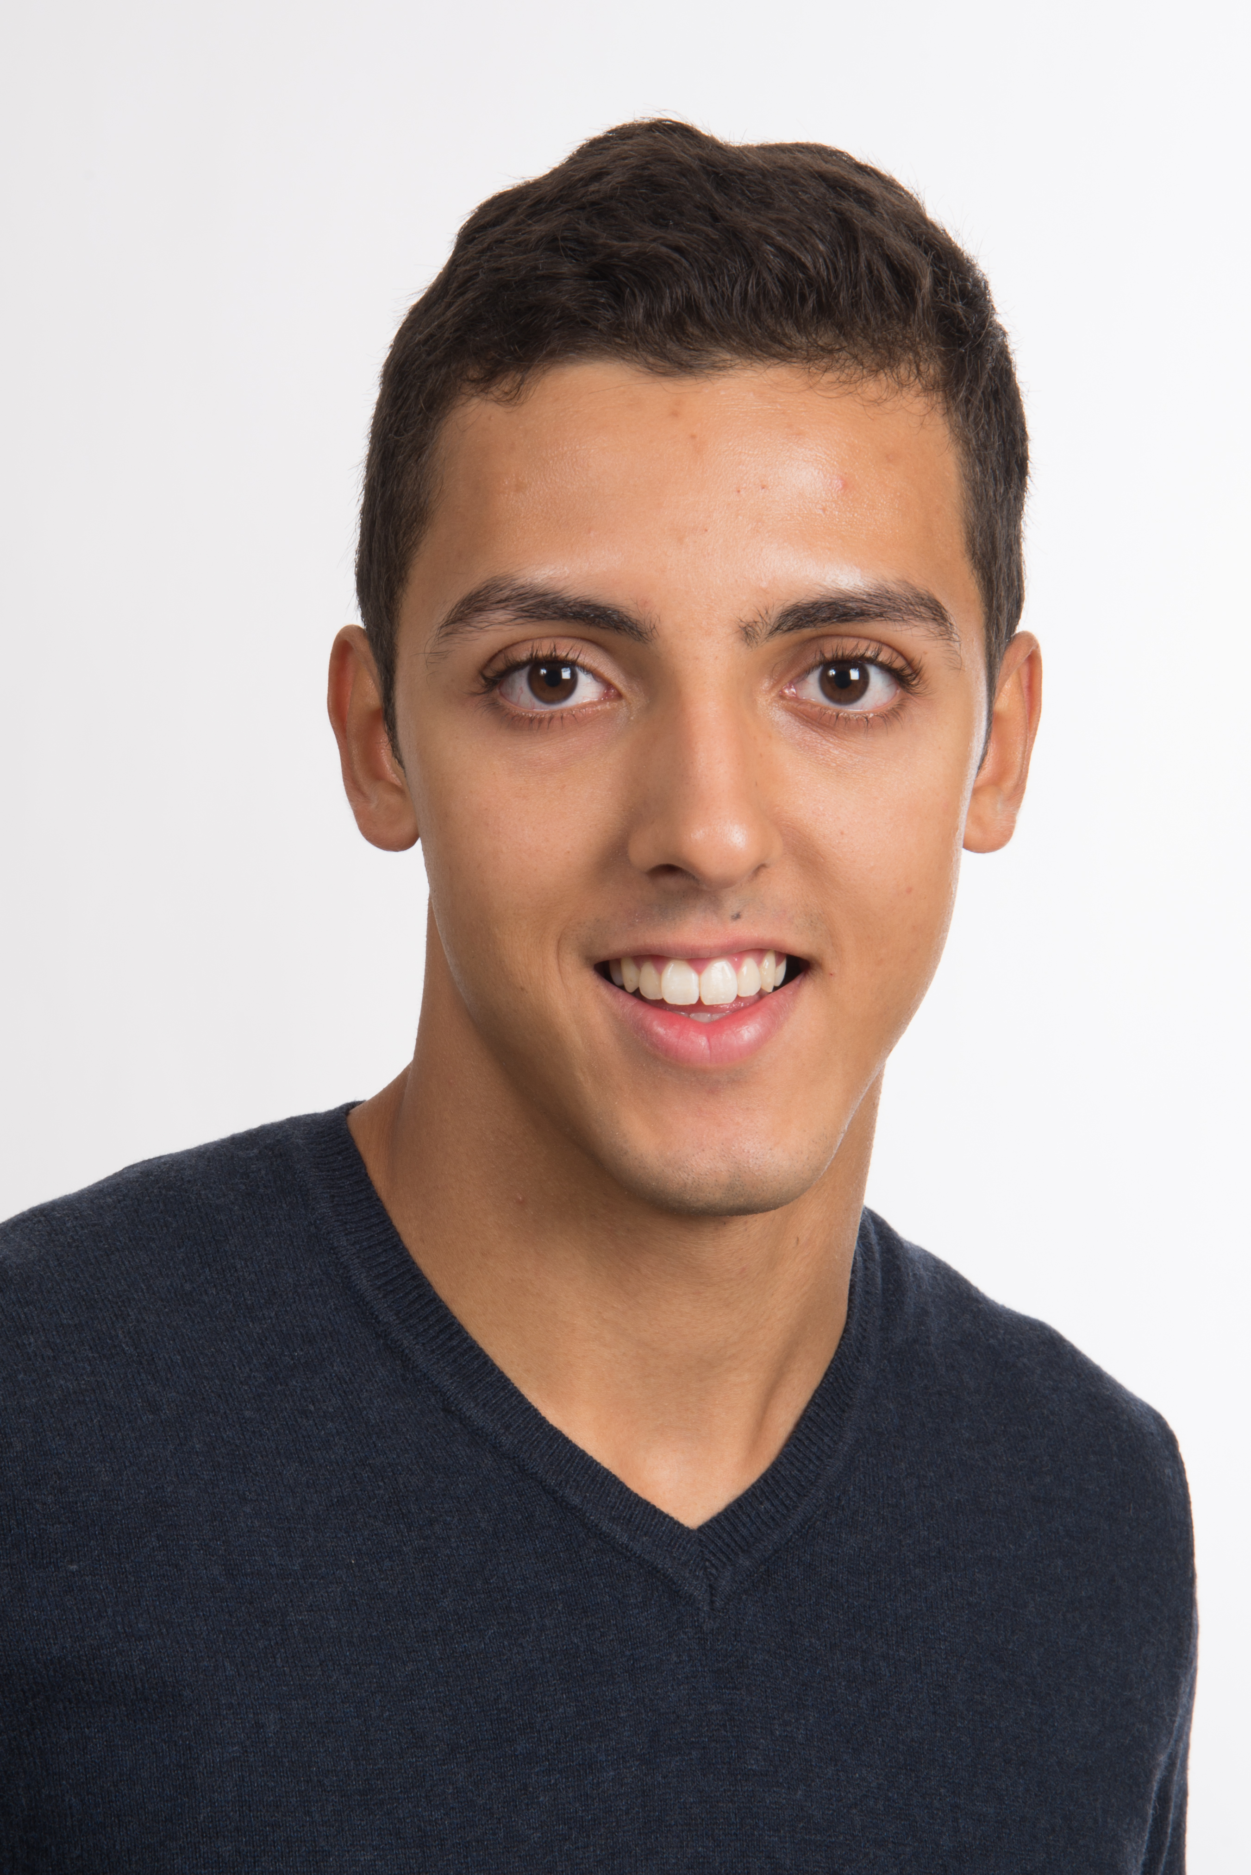
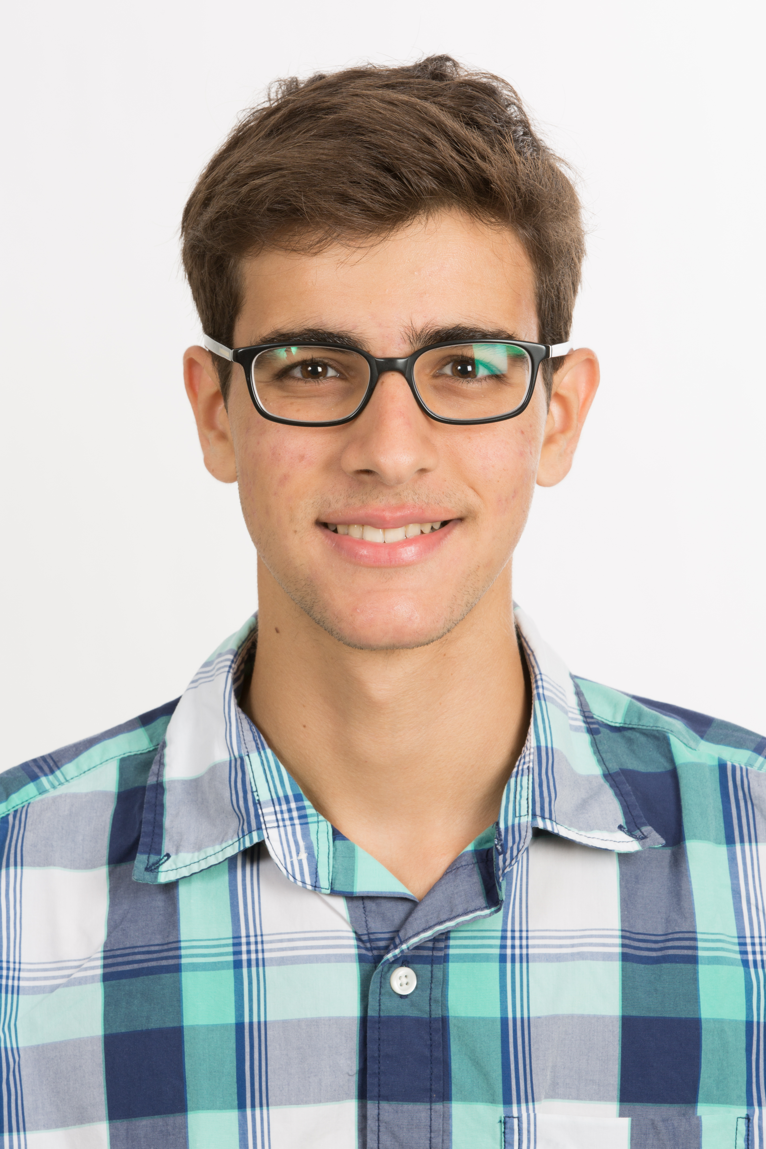
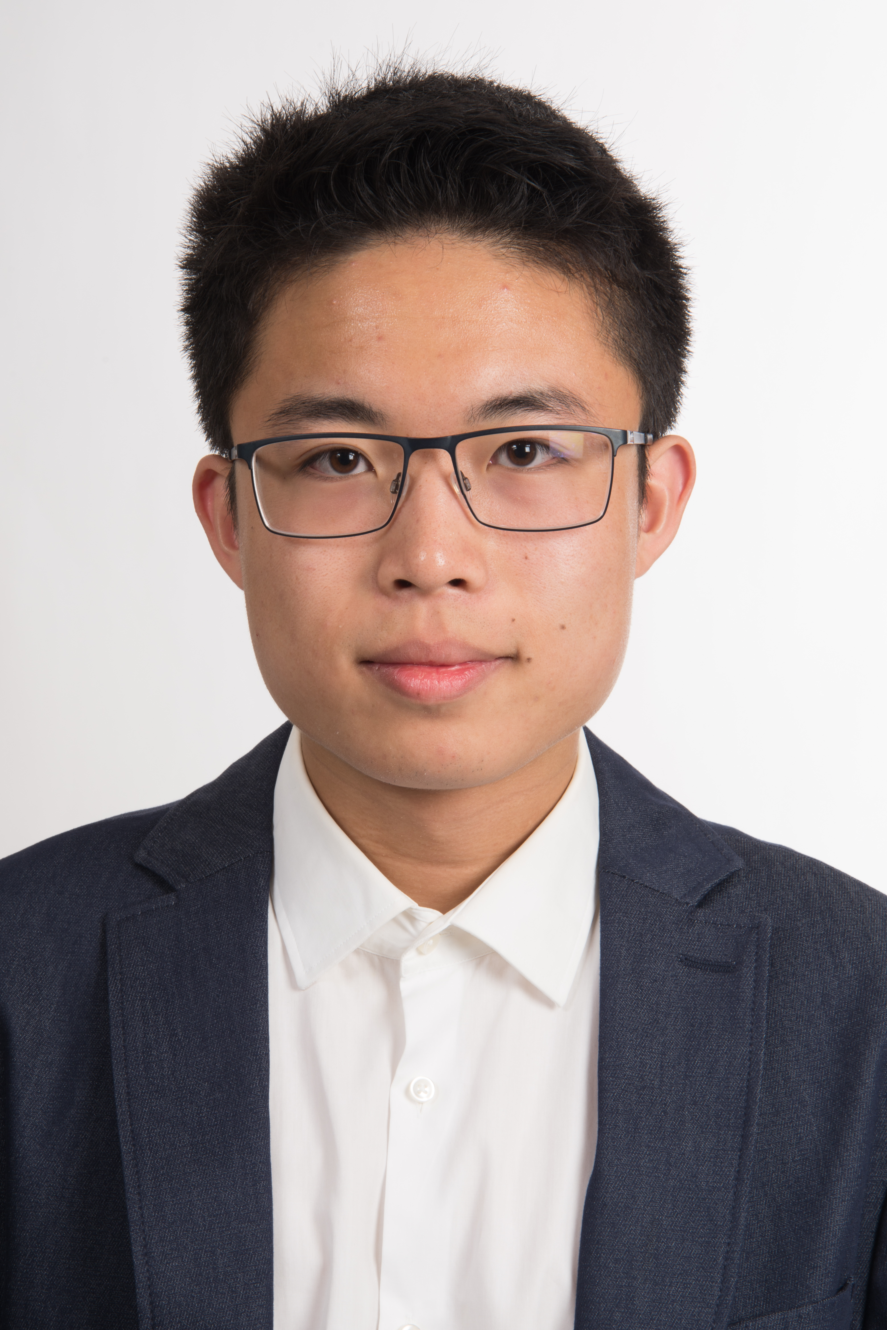
GameEngine Team
Skander MOALLA
Joan
ODEIMI
Kevin
SHEN

Slide 6
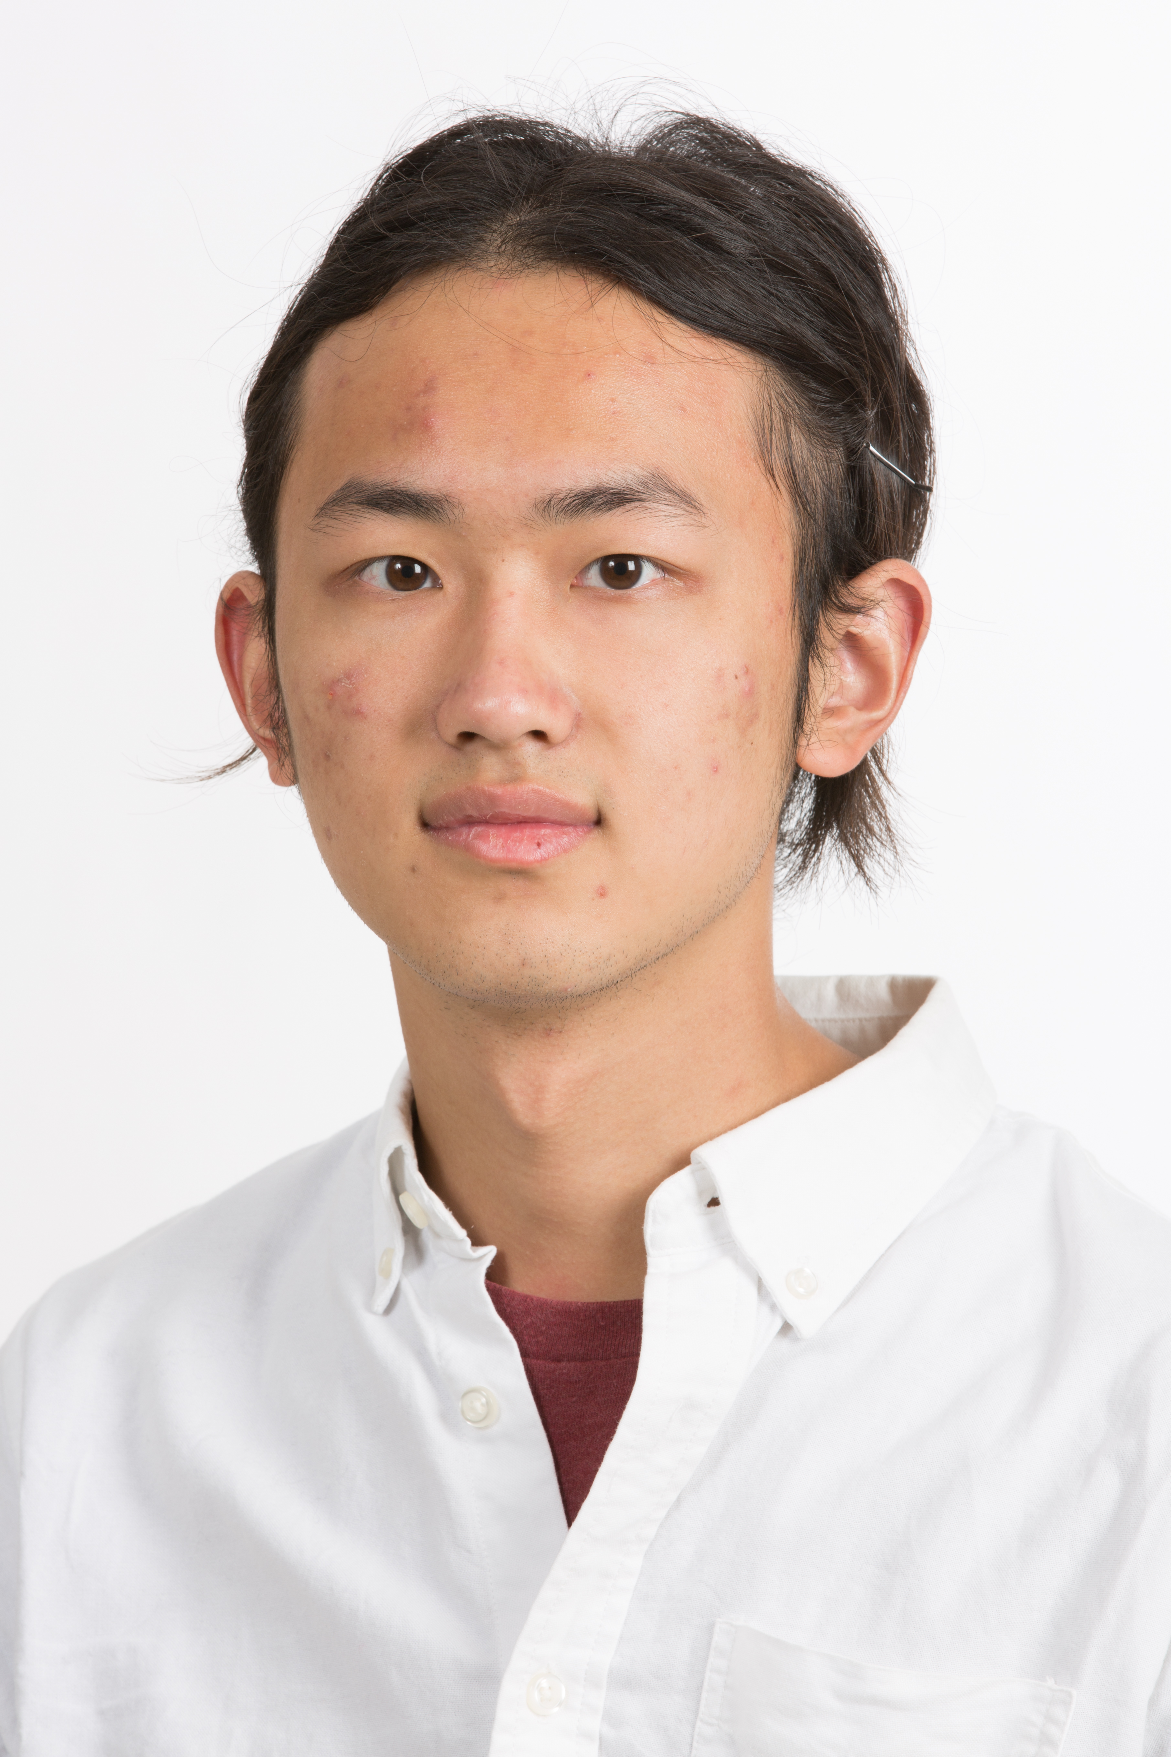
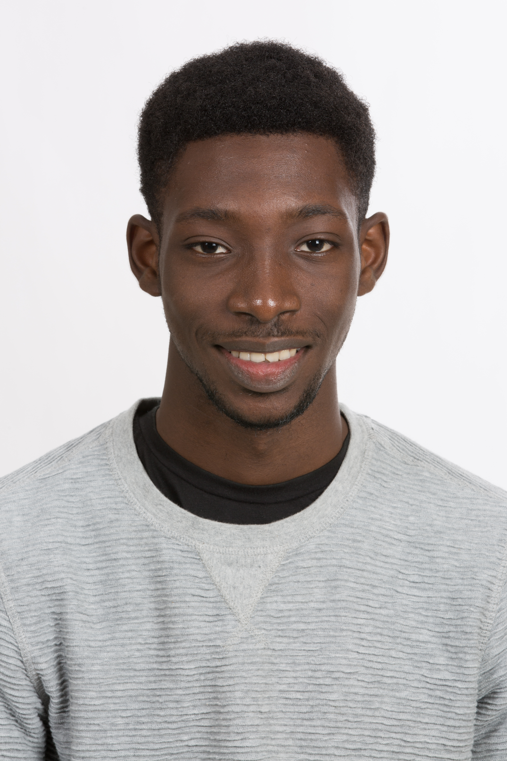
GUI Team
Yinfeng
YU
Abdel-Kader KABA

Slide 7
The General Structure
League class
-Division
-Year
-Teams
-Market
… etc
User class
-Name
-Nationality
-Team
-Budget
… etc
Team class
-Name
-Players
-Points
-Shooting
-Passing
-Rebound
… etc
Player class
-Name
-Picture
-Shooting
-Passing
-Rebound
-Energy
… etc

Slide 8
GameEngine
(Each week)
Simulate the outcomes of the games not played by the manager
Play the managers games
SimulateAutomatedGame
Apply tactics
Simulate outcome of an attack / defence
Make substitutions
(GUI contribution)
Update League rankings
Update Mangers team, budget, energy,…

Slide 9
Team 1
Team 2
Attack | a1
Defense | d1
Motivation | m1
Energy | E1
Etc…
Attack | a2
Defense | d2
Motivation | m2
Energy | E2
Etc…
Game is divided in simple cases: Attack-Defense
Do some heuristics to get the outcome
Apply tactics live
Apply tactics
Make substitutions

Slide 10
Simulate the outcomes of the games not played by the manager
Update Mangers team, budget, energy,…
Fast probabilistic outcome based on Heuristics
Based on ELO ranking system

Slide 11
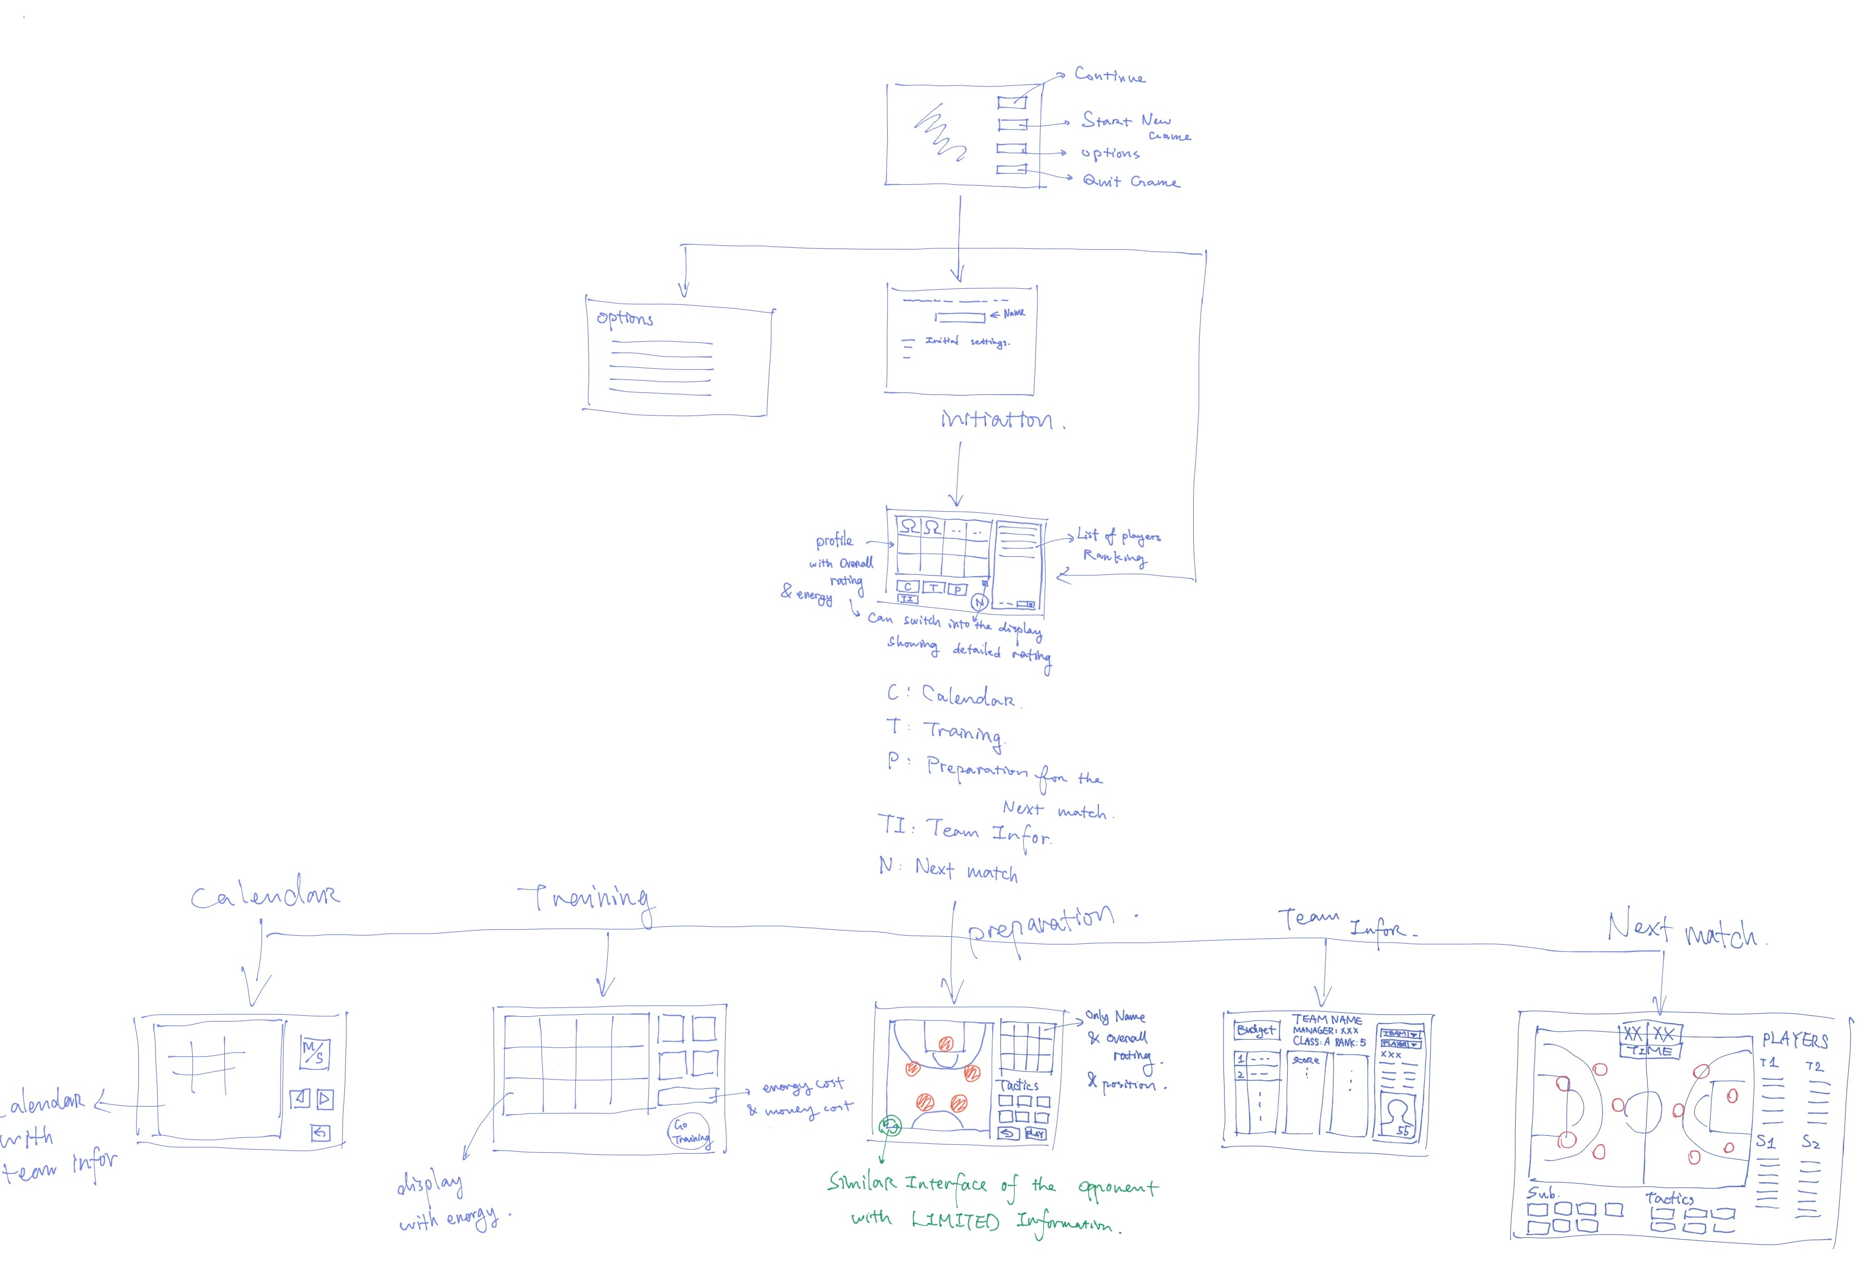
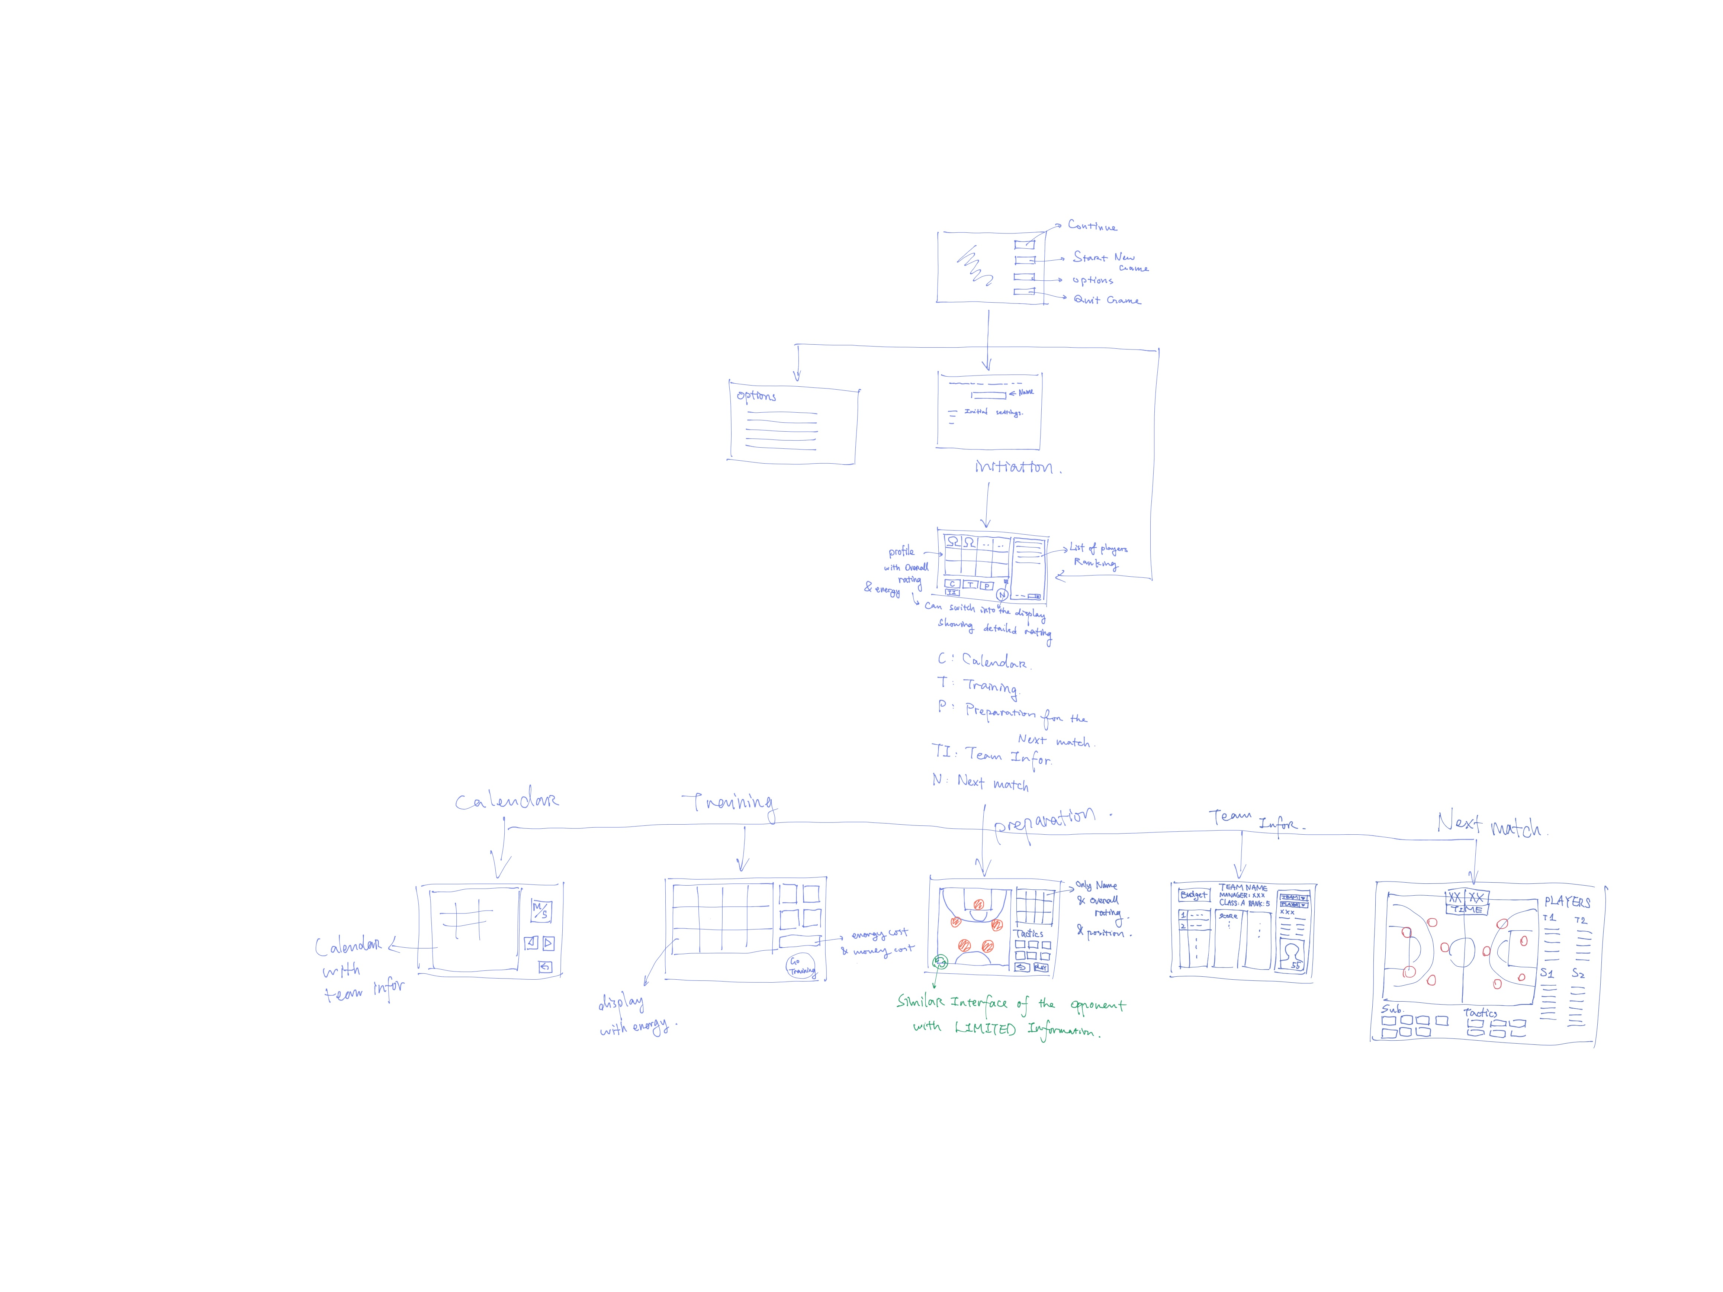
The Graphical User Interface
Sketch of the UI

Slide 12
MainMenu
StartMenu
MainWindow
Calendar
Preparation
Refresh()
Choose()
Substitution()
Training
League Info
Market
Next Game
quarter_timing()
Strat()
Slots for push buttons

Slide 13
Top5
Basketball team MANAGER
FAQ-S

Slide 14
Buy new players in the market.
How do I make my team better?
Train your players, but don’t get them injured or too tired.
Win as many matches
as you can

Slide 15
Buy a player, make him
better, sell him
How to earn money?
Win as many matches
As you can

Slide 16
If your player has disappointed you, you can sell him in the sell section of the market. Don’t forget that a players performance depends on his energy and motivation as well. Don’t push him to the limits, else you won’t get his best.
I don’t like a player, can I sell him?

Slide 17
You can have a look at the live ranking of the league at anytime from the mainwindow. You just need to click the ”League Info” button.
Where can I see the ranking of the league?

Slide 18
Don’t worry! We got this handled! You can check your teams future opponent on the calendar section from the mainwindow. Moreover, before starting the game, you will be able to choose the starting 5 depending on your preferences.
I am stressed, I don’t know which team I will face, and how to prepare for this match?

Slide 19
Yes, the game offers you a SAVING button on the mainwindow, as well as a RESUME button in the beginning of the game.
! Make sure to save the game before exiting !
Can I save the game
and come back later?

Slide 20
Dear Manager, based on the FIBA rules of basketball you are not allowed to have less than 7 players in your team and nor more than 12. This is why it is impossible for you to escape these boundaries.
Can I sell all of my players at once?

Slide 21
Thank you

